Slide 1

MINI PROJECT PRESENTATION
ON
FACE RECOGNITION BASED ON REAL TIME ATTENDANCE FOR ORGANIZATIONS

Slide 2
OBJECTIVE
The novelty of this project (Attendance Registration using Face Recognition) is that we are using the openCV library and face_recognition() package which provides the features such as finding faces, manipulating and identifying faces in the images with high accuracy. In the domain of computer vision and image processing, face recognition is gaining more popularity and has been widely used and further developments are being made. We proposed a system which detects the faces of students from live streaming video of the classroom and attendance will be marked if the face detected is found in the recorded database.

Slide 3
ABSTRACT
Attendance is a compulsory requirement of every organization. Maintaining the attendance register daily is a difficult and time-consuming task. This project provides an efficient and smart method for marking Attendance. Despite the fact that other methods of identification (such as fingerprints, or iris scans) can be more accurate, face recognition has always remained a major focus of research because of its noninvasive nature. This system overcomes the ambiguities like fake attendance, high cost, and time consumption. This system uses a face recognizer library for facial recognition and storing attendance.

Slide 4
INTRODUCTION
Attendance being a very necessary side of administration may normally become an arduous, redundant activity, pushing itself to inaccuracies. The traditional approach of making roll calls proves itself to be a statute of limitations as it is very difficult to call names and maintain its record especially when the ratio of students is high.
Every organization has its way of taking measures for the Attendance of students. Some organizations use document-oriented Approach and others have implemented these digital methods such as biometric fingerprinting techniques and card swapping techniques.

Slide 5
EXISTING SYSTEM
MANUAL ENTRY:
Here the attendance will be marked manually, in a physical register. This can be a tedious job to maintain the record for every individual manually. The human effort is more here.
The retrieval of the information is also done manually as the records are maintained in the handwritten registers.
The accuracy of the data collected is the biggest issue, as the attendance of a particular person can be taken by a third party without the realization of the institution or the organization.
BIOMETRIC SCANNERS:
Attendance is recorded by scanning the biometric features like the fingerprint or iris of an individual.
This is an invasive method of marking attendance. (this system may fail to provide safety in a contagious environment).
A special Biometric scanner needs to be installed on the campus.

Slide 6
DISADVANTAGES
Difficulty in report generating
Manual Control
Time consuming
Accessibility of the information by the legitimate concerned party
Data can be lost
There is a risk of human error

Slide 7
PROPOSED SYSTEM
The task of the proposed system is to capture the face of each person and to store it in the database.
The face of the person will be captured in such a manner that all the features of the person's face will be detected.
There is no need for the supervision of the third party to manually take attendance.
The system takes in a live video stream as input and through further processing the fThe task of the proposed system is to capture the face of each person and aces are recognized and the attendance database is updated.
This system is developed using the python OpenCV library and the face_recognition() package is used.

Slide 8
ADVANTAGES
The speed of the attendance recording process is faster than the previous system.
Able to recognize the face of an individual accurately based on the already known faces database.
Provide a simple spreadsheet for admins to access the attendance database.
The system is completely automated with minimum to no human intervention.
Smart Integration where automatically, emails are sent to the absentees and/or the concerned supervisor or guardian.

Slide 9

SOFTWARE REQUIREMENTS
Python
OpenCV (Open-source computer vision) is a library of programming functions mainly aimed at real-time computer vision
Gcc (C++ compiler which is required by the dlib package)
face _ recognition() library

Slide 10
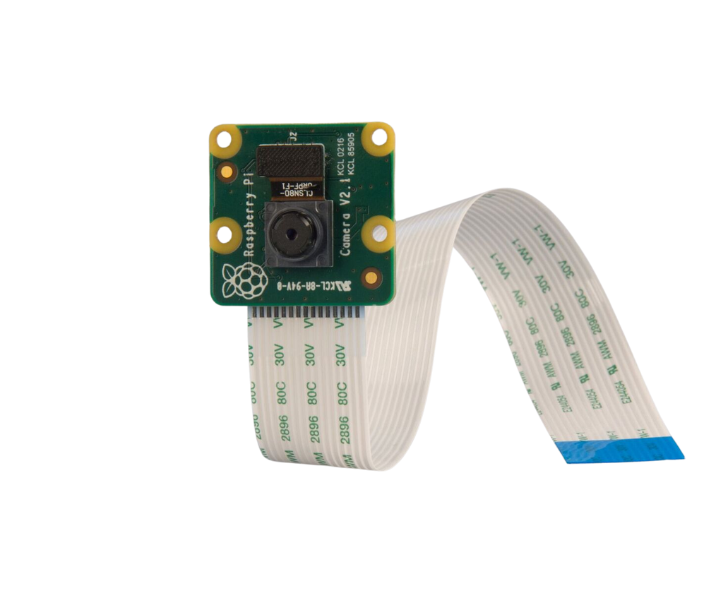
HARDWARE REQUIREMENTS
Camera Module with good resolution
Power Supply Cable

Slide 11



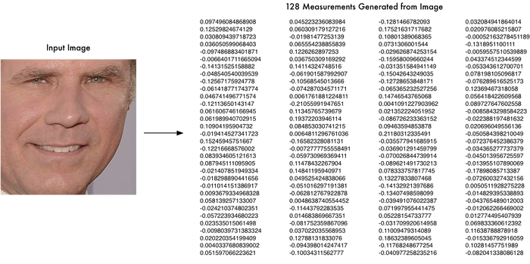




ARCHITECUTURE
The architecture for the proposed system has been designed to keep it pretty straightforward and easy to understand. The steps that must be undertaken to reach the final end step of the system is ensuring the attendance of the student is updated correctly and timely. The system can easily be accessed by anyone, and students' attendance can easily be checked and maintained by the faculty when required. An inbuilt camera module or any USB-based camera module can be used for capturing live video feeds of the class and simultaneously performing recognition for the students. OpenCV-Python will be used to access the camera and the face-recognition library will be used to obtain the encodings of the captured face. then recognition and matching of the captured faces against the stored faces available in the previously acquired data sets are done to finally update the attendance.
Captured video is segmented and individual faces are obtained
Live Video feed is captured
Attendance is marked with date and time if the captured face matches with the trained dataset in the database
Encodings of each face is calculated
(Contains all encodings and faces used as training data)

Slide 12
MODULES SPLIT-UP
Finding the no. Of Unique classes
Access camera and prepare images
Find Encodings
Match detected faces with Training image
Mark Attendance

Slide 13
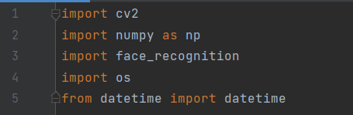
MODULES
Importing Libraries

Slide 14
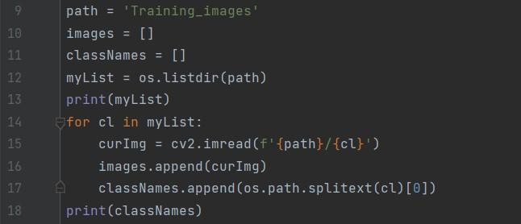
MODULES
Finding the no. Of Unique classes

Slide 15
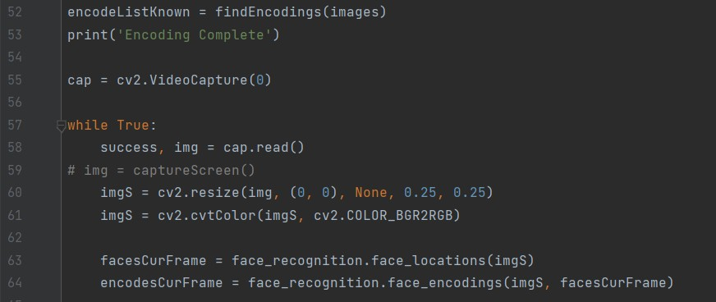
MODULES
Access camera and prepare images

Slide 16
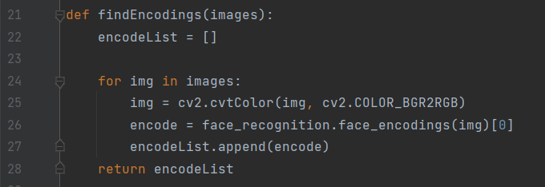
MODULES
Find Encodings

Slide 17
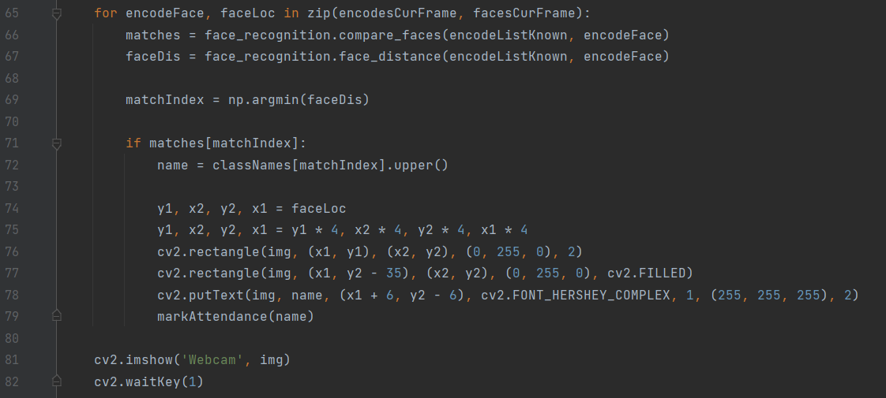
MODULES
Match detected faces with Training Images

Slide 18
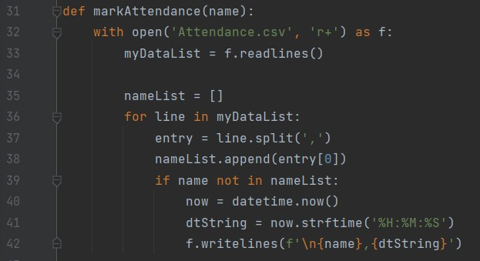
MODULES
Mark Attendance

Slide 19
REFERENCES
Robinson-Riegler,G.,&Robinson-Reigler,B.(2008).Cognitive psychology:applying the science of the mind.Boston,Pearson/Allyn and Bacon.
Margaret Rouse.(2012).What is Facial recognition? –Definition from WhatIs.com[online] Availabe at:http://whatis.techtarget.com/definition/facial-recognition.
Solon, O. (2017). Facial recognition database used by FBI is out of control, House committee hears. [online] the Guardian.Available at: https://www.theguardian.com/technology/2017/mar/27/us-facial-recognitiondatabasefbi-drivers-licenses-passports[Accessed 25 Mar.2018].

Slide 20
CONCLUSION
This system aims to build an effective attendance system using face recognition techniques. The proposed system will be able to mark the attendance via face Id. It will detect faces with help of a camera module and then recognize the faces. After recognition, it will mark the attendance of the recognized person and update the attendance record. Using technology to conquer the defects cannot merely save resources but also reduces human intervention in the whole process by handling all the complicated tasks to the machine. In the end, the system not only resolves troubles that exist in the old model but also provides convenience to the user to access the information collected by mailing the attendance sheet to their respective supervisor or guardian.

